Slide 1
ARUS 280 HW #14
Chapaev (Georgi and Sergei Vasiliev, 1934, 1:31)
Beumers’sCinema, Stephen Hutchings, “CHAPAEV,” 69–78
David Gillespie’s Russian Cinema on the “Vasiliev Brothers’” film Chapaev.

Slide 2
Chapaev (Georgi and Sergei Vasiliev, 1934)
 | Group A | Group B
Class 1 | 82 | 85
Class 2 | 76 | 88
Class 3 | 84 | 90
EVERY 5 MIN

Slide 3
5 MIN link https://www.youtube.com/watch?v=4B4wx4J3YSM
The scene takes place on a field
A man with a machine gun vechicle rallies men
They head to a bridge and drive away the soldiers there
The general seems to tell two men to go swim and have something done
While they are waiting a singing regiment comes along

Slide 4
5 MIN
The head of that regiment meets the blond general
The blond general is smoking a pipe
A women comes from a carriage to smile at the general
These are very young looking people
Men are swimming out of the river where the general ordered them to swim in
Then were are taken to the camp where the blond general shoots into the air for his subordinates to hold a meeting
They hold a meeting discussing war strategy
Then were are taken to a home were a man walks a in a room with two other men

Slide 5
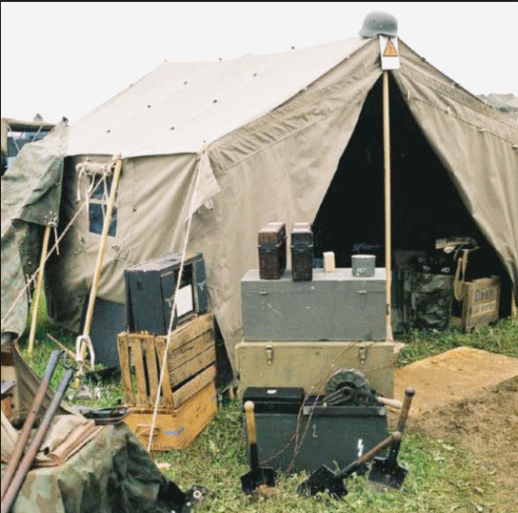
5 MIN
In the room dark haired man is shouting at two men because they were making the sweet potatoes the wrong way
Then a scene with the blond general and the other general’s wife and they are fixing a primitive machine gun in the field
The blond general tries to commit adultery with the woman, but she not down with it
He offers to help her finish fixing the machines but she refuses
Next we are taken to a scene where hand
somely dressed generals are taken to a a
tent that looks like this

Slide 6
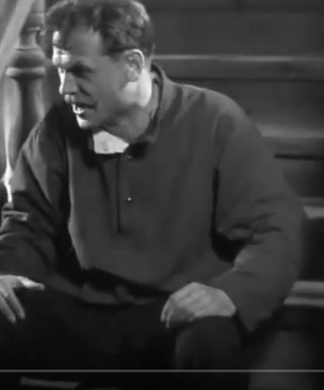
20 MIN
So the black haired general are talking and smoking a joint
Then we come to a scene which looks like a house where two guys approach a guy in a overcoat
They start shouting wanting something
Then that guy pulls up and shouts at them
They get in order and leave,
he shouts at the guy with the overall and he breaks a chair
They the guy in the overcoat talks to him as if he is stressed out
That guy looks like the general I saw earlier

Slide 7
25 MIN
the general went upstairs and as he was heading upstairs they both started to laugh together
a general is talking with another man, an officer gives the bald head general a letter
then a young men go wake up young men to go do something in a house, and he goes to grab a pig
an elderly woman shouts at him for taking the pig

Slide 8
5 MIN
the guy runs off
two guys hit a joint
the gerenal upbraids an officers, tells him he needs to calm down
two guys pull up and he shouts at the general
they dont let him leave
the general tells him to remove his badge jacket and gun
the guy discusses his case with the general

Slide 9
5 MIN
he countinues to try to talk sense
another comes in to discuess something important,
he talks some sense into the guy
another guy is spying
outside the guy gives an announcement
bearded ppl are looking at him speak
they agree

Slide 10
5 MIN
a guy from the crowd ask a questions
the general is smoking a pipe the whole time
the blond general is with the other generals wife congratualitng her for fixing the machine he is happy for her
he tells her that he is leaving, that might be the husband actually

Slide 11
5 MIN
we see a river
a man tries to shoot another man but his gun is empty or he cannot fire it
they talked, the man trying to shoot the husband talks as is he failed at something, but they were playing
at a generals office the husband tells him to get straight,
the bald general is playing music while another general dances with wooden shooes
he seems to be cleaning the floor

Slide 12
5 MIN
he looks at the letter then the bald general angrilly and he says something
the bald general stops playing
two watchmen are talking and shoot into the night
the general comes to see them
another guy shows up, the seem to be planning a revolution they almost shoot him
the general goes to another room and talks with the man that he upbraded earlier.
He seems to be mapping some

Slide 13
55 MIN
a man is singing while another man is sleeping, he wakes up and they talks
he thinking about how they should draw up a plan
he gets mad and rools up in his bed
on a hill the people prepare theirselves including the wife,
a man is on a horse the upbraided officer and sends the husband down the hill

Slide 14
5 MIN
a man drops off hay it seems
a guy comes up a hill to warn the people
a guy talks to a group of poeple, another guy pushes him off but the general shoots him
they receivee orders and assemble
a child talks to a dad
the emeny is comming they are marching in fine apprael
a man dies

Slide 15
5 MIN
they see them coming closer ready to shoot
the wife prepares the machine gun
they wait till they are in range,
the wife mows them down with the machine gun and they throw grendades and they scatter
they a calvary comes
but they have calvary too and the enemy retreats
they look at their victory poster

Slide 16
5 MIN
the wife comes into the room
she wants to see plans, and they give them to her and they let her eat
he husband feeds her
the guys are singing a song
they get ready to go and they read a letter and meet two men
they wave someone off in an automobile

Slide 17
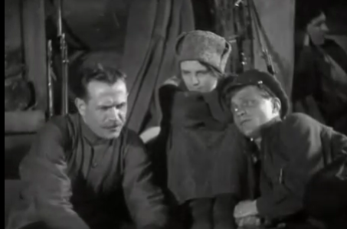
5 MIN
the well dressed generals are planning again looking at a good map
they discuss a sucessful stragetgy
then the men with his wife sing a song, one man is chilling someone goes talk to him he is alright
that man then goes talk to the
husband and his wife holding a long
needle

Slide 18
5 MIN
they all start to sing
the man continues to talk
he talks to her wife
later they fall asleep
generals seem to be marching through the night
they kill the sleeping watchmen
the general fires a shot into the sky

Slide 19
5 MIN
they start to raid
the ppl wake up
the invades put fire to the whole place,
they set up the machine gun and gun down everyone
the guys says watch my six
another man goes to take down the tank
the guy with the machine gun is shot by the tank,
the guy goes behind the tank and throws mozzletoff on the tank

Slide 20
5 MIN
the invaders pull up with a cannon and they run early, taking the machine gun out
they seem to rally the next day
the wife is given a cup to drink
he takes the injured man with a machine gun down a hill running away from the invaders
the blond guy gets shot as he gets into the water he dies
the guy swimming in the water gets mowed down by a machine gun
peeople with horses come to the hill, and seem to kill off the invaders at the hill

Slide 21
Beumers’s Cinema, Stephen Hutchings, “CHAPAEV,” 69–78
 | Group A | Group B
Class 1 | 82 | 85
Class 2 | 76 | 88
Class 3 | 84 | 90
EVERY 5 MIN

Slide 22
pg 69-70
Chapev (1934) made by Geogii and Sergei Vasilev, nicknamed the 'Vasilev' brothers, they made films before
it became a very famous film, as soon as it was released
Chapev was made the same period sound was coming into film
movie based on Dmitrii Furamov (1891 - 1926), autobiography while there was a civil war raging from 1919-1921
a guy named Klychov comes in and takes over and reeducates Chapev and tries to keep everyone in order. Chapev gets while trying to cross the

Slide 23
pg 71-72
Klychov account made Chapev famous
the novel is contradictive but interesting
1924 Furanmov submitted a form to make his book into a film but it was lost and forgotten, his widow did it again in 1932 and the Vasliev brothers took care of it
humor is emphasied in the film, when Anna polishes the gun and tells Pet’ka to stay away
film has a more definitve path than the book

Slide 24
pg 73-74
the plot in the book and the movie are different
at the end of the book Chapev dies like he is cornered and there is no way out, in the end of the movie, Chapev dies trying to fight off the white army
Furamov made sketch-like summaries of scenes while the movie made each scene seperate and integrated to one plot
the film wasn’t only for adapting the novel but also for making it a Soviet film, so different aspects had to be changed
sound was post produced, in a studio room which sounds like everyone is echoing

Slide 25
pg 75
in this movie people switch sides alot, as they get to know more about what is going on
movie contains lore about Chapev death, and Black Raven, a song about death
after the film everyone started to rename things after Chapev

Slide 26
pg 76- end
Furamov had a problem writing this book in the Stalin period, basically it was a contradiction to Soviet ideals because the main character (Pet’ka) was too sponteaneous
Chapev lives on, people made folklore about and and made a video game about it

Slide 27
David Gillespie’s Russian Cinema on the “Vasiliev Brothers’” film Chapaev.
 | Group A | Group B
Class 1 | 82 | 85
Class 2 | 76 | 88
Class 3 | 84 | 90
EVERY 5 MIN

Slide 28
The model of the Soviet art of adaptation was established in the ‘golden age’ by Vsevolod Pudovkin in his film of Gorkii’s novel Mother […] and Grigorii Kozintsev and Leonid Trauberg with their 1926 adaptation of Gogol’s The Overcoat, with its self-conscious use of silhouette and shadow. Pudovkin’s didacticism and obvious symbolism, and the startling
Furmanov’s novel was first published in 1923. The author had served as political commissar in the 25th division of the Fourth Army, led by Vasilii Ivanovich Chapaev
Furmanov said his soldiers thought he was a hero

Slide 29
why Soviet call people civil war hero’s it was all because of Furmanov when he named Chapev a war hero
Katerina Clark (2000) described Klychkov, an educated, selfless working-class Party official,
she described Chapaev, by contrast, is a semiliterate peasant leader and is a bossy guy who is confused about party values
Basically Klychov figures out what is going on, takes over gets help from Petka but everyone dies in the end
just like American patriotism, Soviet people who forught and died for their values

